Slide 1
Project: Virtual Queue 2.0 Student: Kenneth Kon Michael Lazo Mentor: Bernard Parenteau
Intro Video
CIS 4911 Senior Project
School of Computing and Information Sciences
Florida International University

Slide 2
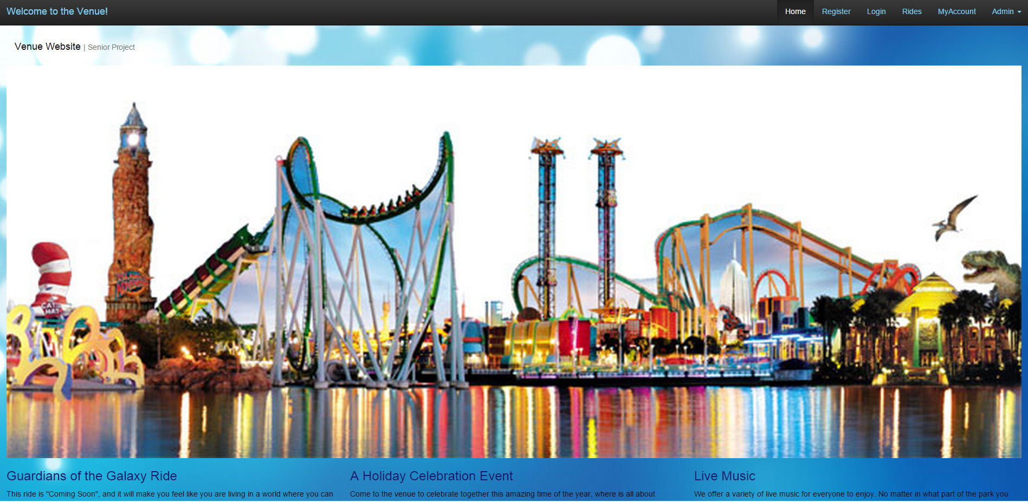
Virtual Queue
Notes:
Explain the scope of the project. What it is. Target client.

Slide 3
Role
Name | Roles | Tasks | Periods required | Key Phases
Kenneth Kon | • Developer • Scrum master (ALT.) • Test Engineer • Document Editor | • Project Status • Schedule/Task • Implementation • Testing • Project Documentation | 1/12/15 to 05/01/15 | All
Micheal Lazo | • Developer • Scrum master (ALT.) • Test Engineer • Document Editor | • Project Status • Schedule/Task • Implementation • Testing • Project Documentation | 1/12/15 to 05/01/15 | All
Notes:
Say developer and tester

Slide 4
Virtual Queue v1.0
Problem Definition
VQ is an online alternative to standard waiting lines that currently exist in theme parks today
Existing System
An online web-application in which users can log in and add ride instances
Limitations
Visitors must have internet access at all times
No administrative rights
No active Queue

Slide 5
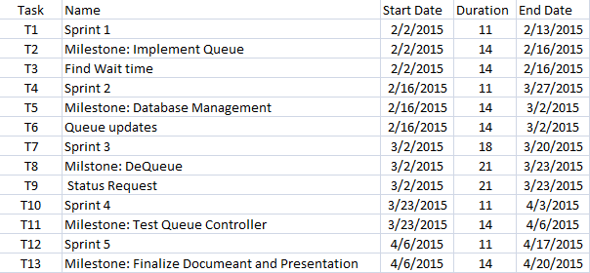
Product Management

Slide 6
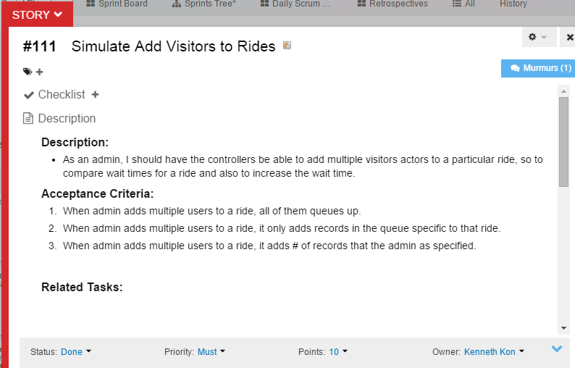
User Story

Slide 7
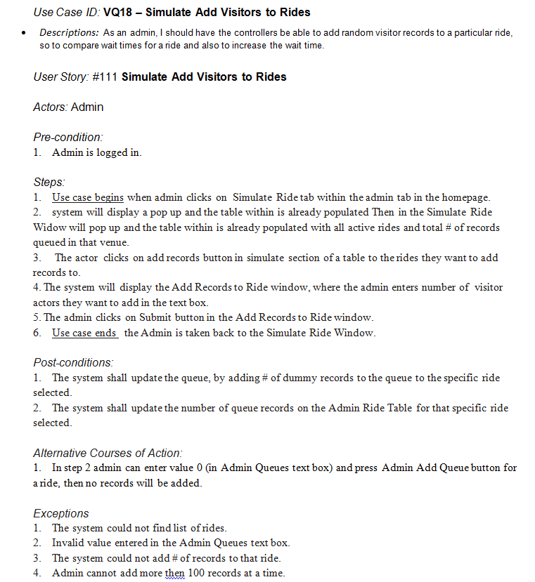
Simulate Add Visitors to Rides

Slide 8
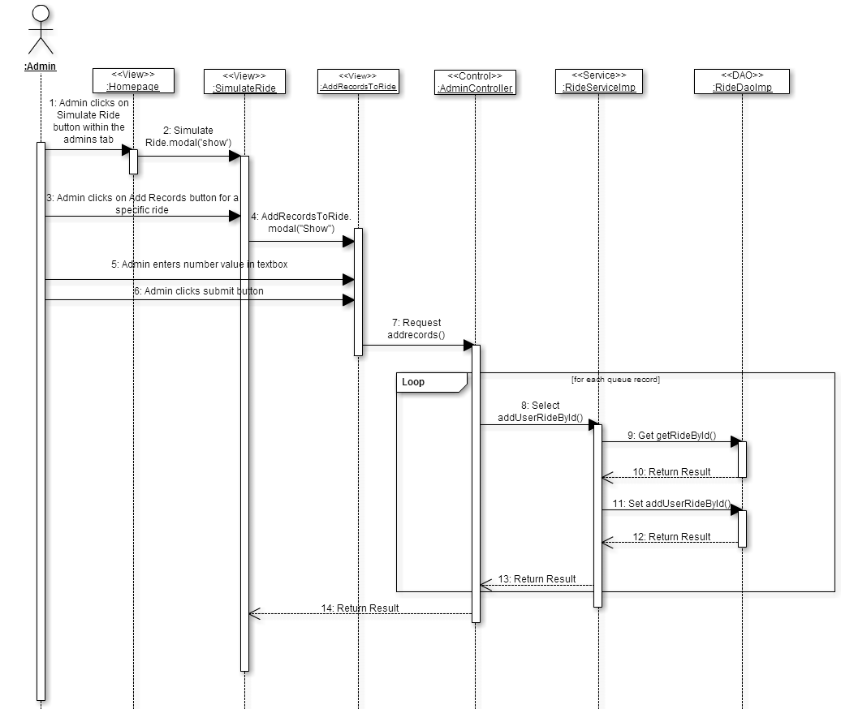
Simulate Add Visitors to Rides

Slide 9
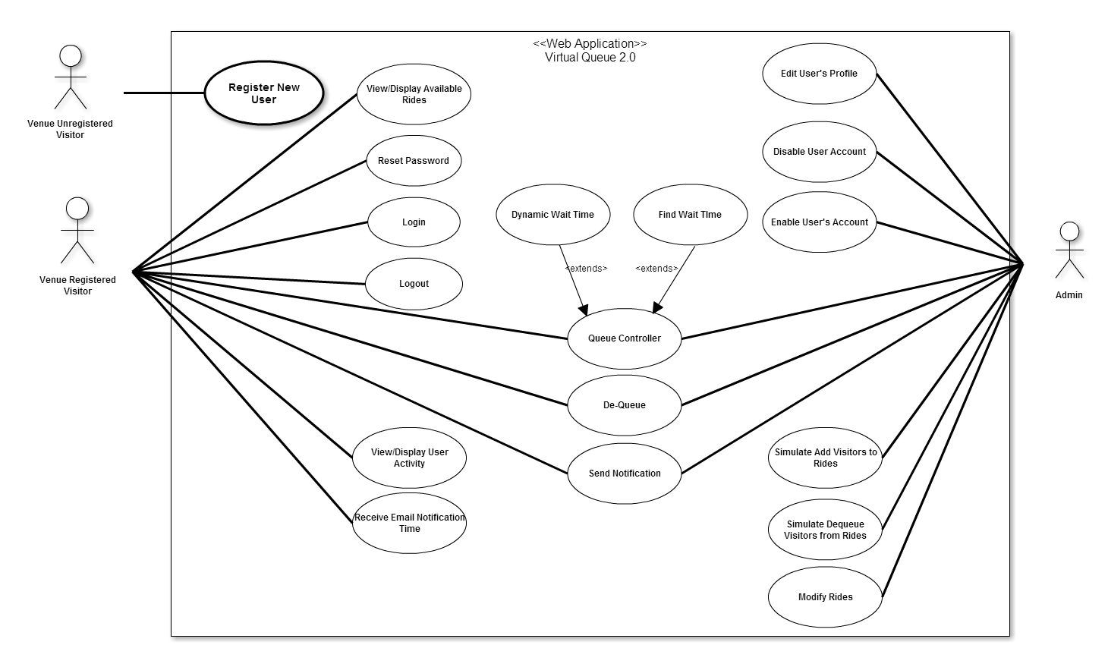
Use Case Diagrams

Slide 10
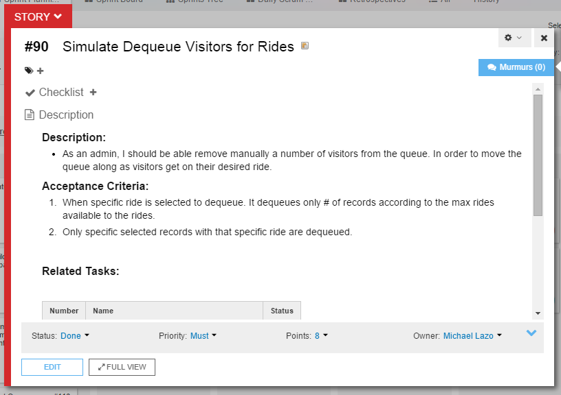
User Story

Slide 11
Simulate Dequeue Visitors to Rides
Use Case ID: VQ19 – Simulate Dequeue Visitors from RidesDescriptions: Admin has ability to remove queues records for particular rides.
User Story: #90 Simulate Queue for admin: Add Multiple Visitors to Rides
Actors: Single Venue Admin
Pre-condition:
1. Admin is logged in.
Steps:
1. Use case begins when admin clicks on admin ride tab.
2. Then the Admin Ride Table will be populated with all active rides and total # of records queued in that venue.
3. Use case ends the Admin presses the Admin Remove Queue button for specific ride from the table.
Post-conditions:
1. The system shall update the queue, by removing # equal to the rides max capacity.
2. The system shall update the number of queue records on the Admin Ride Table for that specific ride.
Alternative Courses of Action:
1. In step 3, User does not press the Admin Remove Queue button.

Slide 12
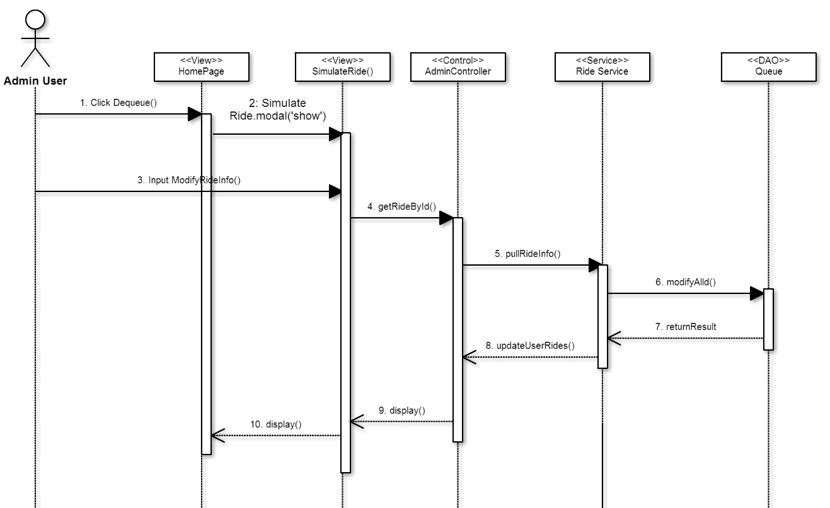
Simulate Dequeu Visitors for Rides

Slide 13
System Decomposition
Architecture
Three Tier
These will allow for horizontal scalability, which will let to multiple server instances to easily handle high traffic on the site.
Multilayer architecture
Allows decoupling each layer using interfaces contracts only to communicate between them.

Slide 14
System Deployment
H/W requirement
Computer/Smartphone with internet connection
S/Q requirment
Windows 7 or higher, with or without Virtual Machine
Tomcat version 8
Sprint 4.0 Framework
MySQL
Notes:
It is being hosted on a virtual machine with windows 7 running with JBoss 7.1 application server and Spring 4.0 framework and MySQL database on the FIU SCIS network. Below is the representation of it.

Slide 15
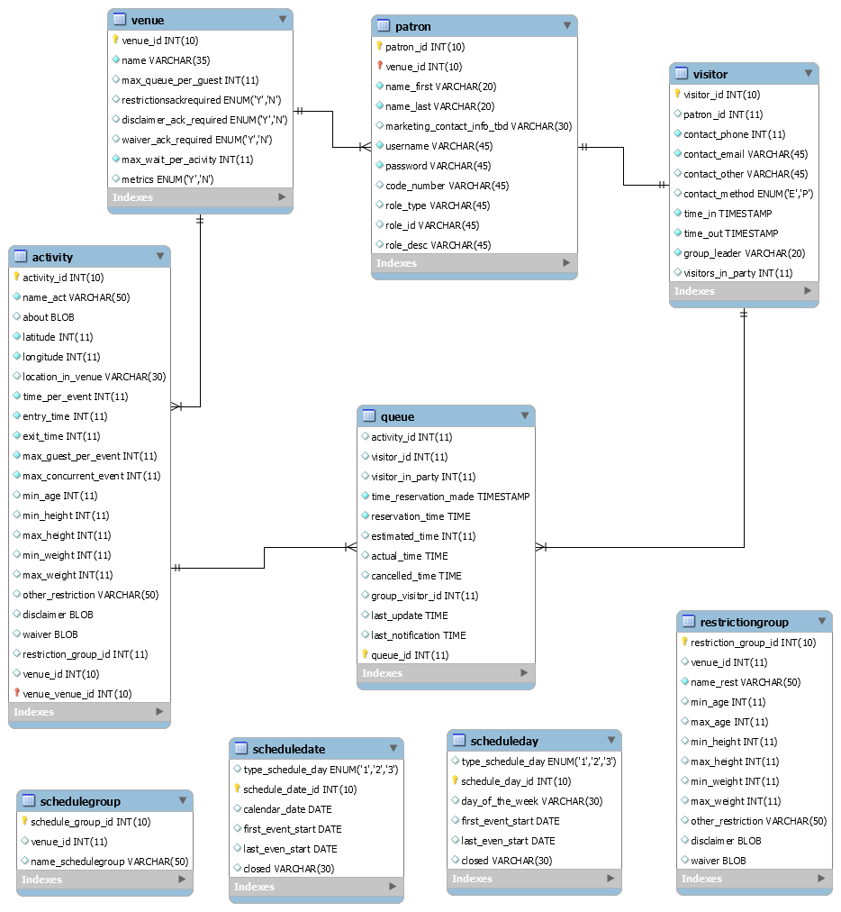
Persistant Database Management
Notes:
It is being hosted on a virtual machine with windows 7 running with JBoss 7.1 application server and Spring 4.0 framework and MySQL database on the FIU SCIS network. Below is the representation of it.

Slide 16
Security/Privacy
Object Actor | Account | Profile | Ride
Authenticated User | Change Password | Update | Add/Remove from Queue, Check Ride Status
User Admin | Change Password, Access other Accounts | Update | Add/Remove visitors from Ride, Edit Rides
Anonymous User | Create
Notes:
It is being hosted on a virtual machine with windows 7 running with JBoss 7.1 application server and Spring 4.0 framework and MySQL database on the FIU SCIS network. Below is the representation of it.

Slide 17
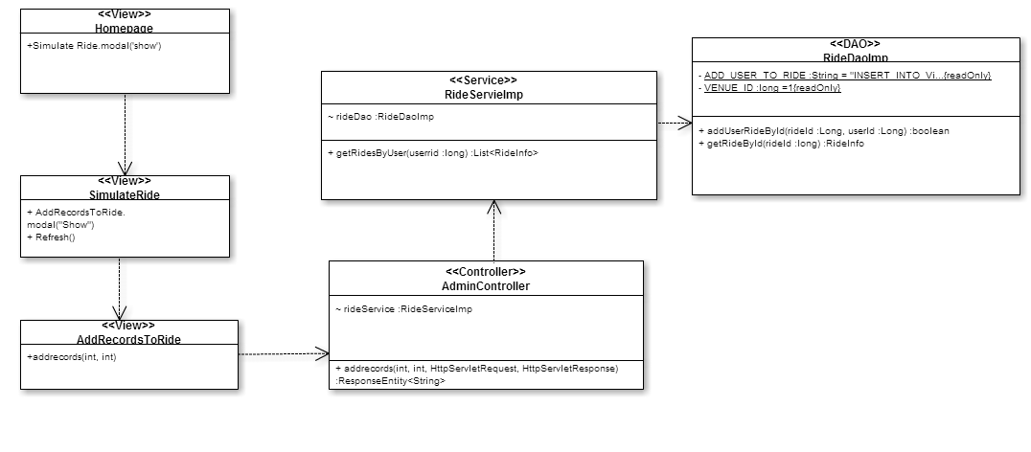
Class Diagram Simulate Add Visitors to Rides

Slide 18
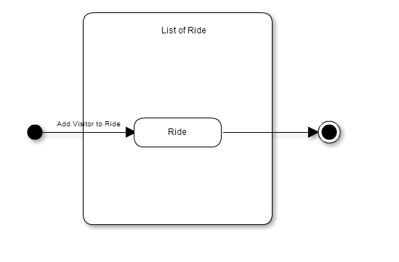
State Machine Simulate Add Visitors to Rides

Slide 19
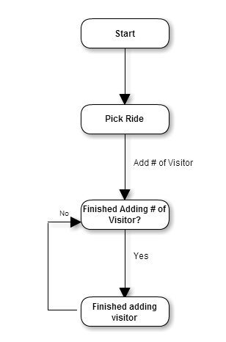
Algorithm Simulate Add Visitors to Rides

Slide 20
Test Cases: Sunny Day Simulate Add Visitor to Rides
Test ID | VQ_002.01_Simulate_Add_Rides
Purpose | To successfully add records to the queue for the specified ride.
Preconditions | Venue Admin is signed in to the system, has Simulate ride table open. Clicks on add records for "Splash mountain."
Inputs | Add Random Records: 10 Ride Id: 1
Expected Response | Splash Mountain should be the only record updated with increase in # of records and increase in Wait Time.
Actual Response | In Simulate Ride Table: Splash Mountain: (Total # records)+10 and Wait Time Increased.
Result | Pass
Comments | N/A

Slide 21
Test Cases: Rainy Day Simulate Add Visitor to Rides
Test ID | VQ_002.03_Simulate_Add_Rides
Purpose | To successfully add correct number of records to a specified ride.
Preconditions | Venue Admin is signed in to the system, has Simulate ride table open. Clicks on add records for "Splash mountain".
Inputs | Add Random Records: Apple Ride Id: 1
Expected Response | Error Message: "The Value entered in Add Random Records is not a valid value"
Actual Response | Error Message: "The Value entered in Add Random Records is not a valid value"
Result | Pass
Comments | This can occur is Admin adds Value greater than 100. Cannot add more than 100 random records at a time.

Slide 22
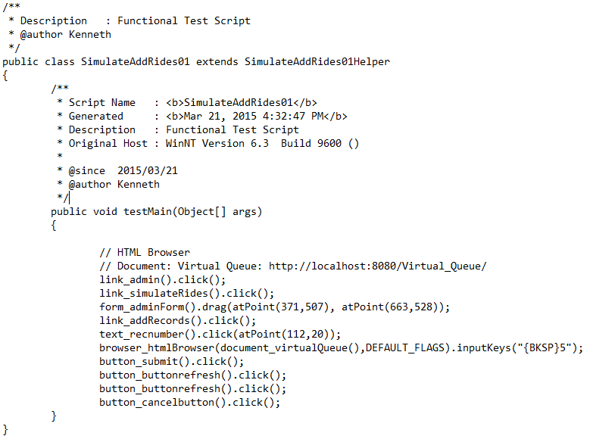
Test Script Simulate Add Visitor to Rides

Slide 23
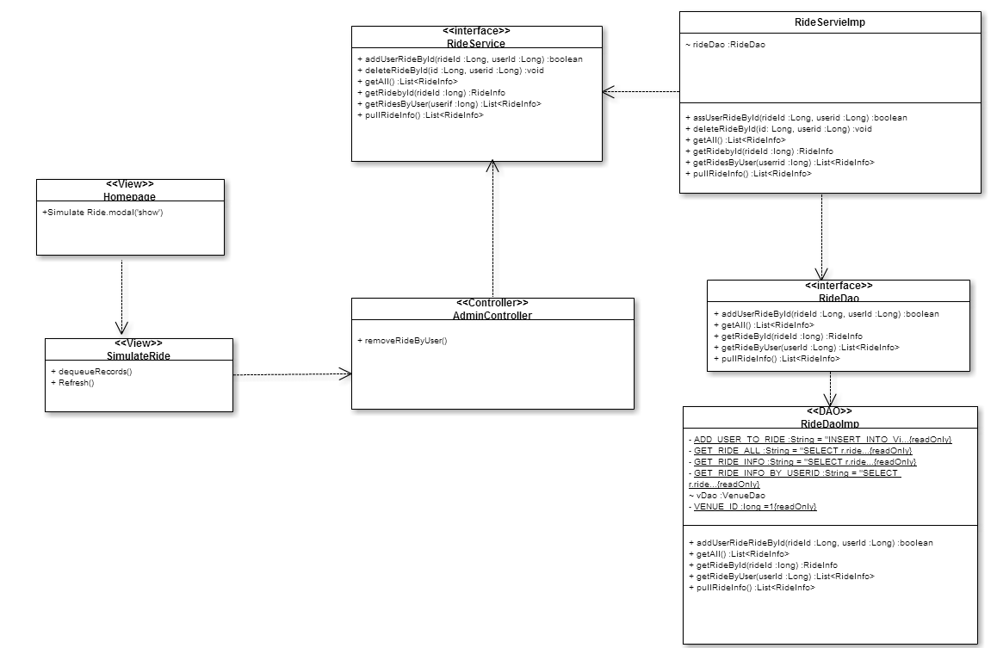
Class Diagram Simulate Dequeue Visitors for Rides

Slide 24
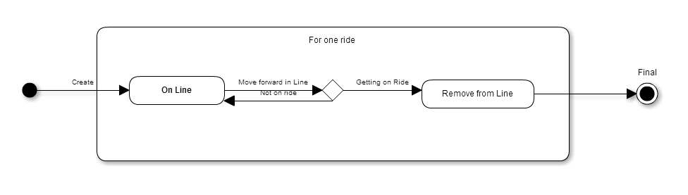
State Machine Simulate Dequeue Visitors for Rides

Slide 25
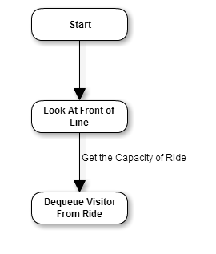
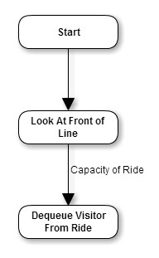
Algorithm Simulate Dequeue Visitors for Rides

Slide 26
Test Cases: Sunny Day Simulate Dequeue Visitors for Rides
Test ID | VQ_002.06_VisitorDeque
Purpose | To allow users to remove themselves from queue and display updated user “MyAccount”
Preconditions | User is signed in to the system and has saved their edited/new schedule
Inputs | Activity sets with their corresponding wait times
Expected Response | “MyAccounts” list of users activities be updated to remove the selected ride
Actual Response | “MyAccounts” list of users list of activities is updated to not include the selected ride
Result | Pass
Comments

Slide 27
Test Cases: Rainy Day Simulate Dequeue Visitors for Rides
Test ID | VQ_002.06_VisitorDeque
Purpose | To allow users to remove themselves from queue and display updated user “MyAccount”
Preconditions | User is signed in to the system and has saved their edited/new schedule
Inputs | User clicks remove multiple times before receiving the “Removed Succefully” notification
Expected Response | “MyAccounts” list of users list of activities be updated to remove the selected ride multiple times
Actual Response | “MyAccounts” list of users list of activities is updated to not include the selected ride
Result | Pass
Comments

Slide 28
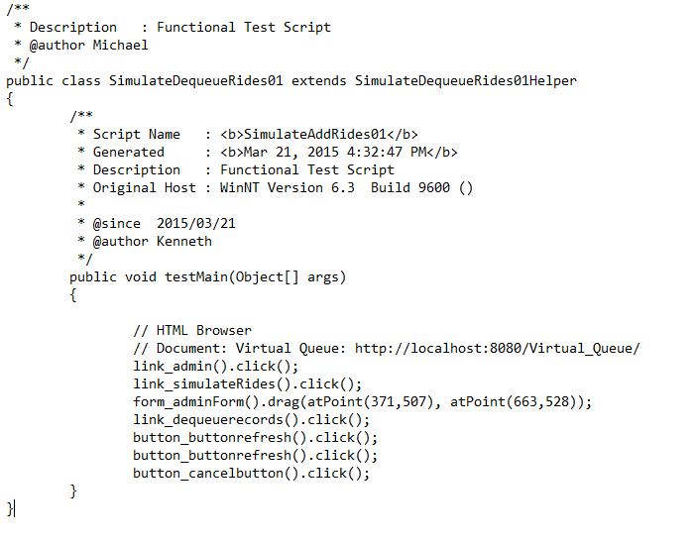
Test Script Simulate Dequeue Visitors for Rides

